Slide 1


STIMULATION & CHARACTERISATION OF NANOSCALED FET
AY 2021-25
GITAM UNIVERSITY
Major Project
A University should be a place of light, of liberty, and of learning.
Department of Electrical Electronics and Communication Engineering
Project Team:
. Niharika Sidda
. Jillela Mounika
. Pasupuleti Sushanth
Project Mentor:
. Dr.Ajit Kumar
www.gitamedu.com

Slide 2

Project Group – Details
Photo
Track
Roll No
Name
Photo
EECE AI/ML
BU21EECE0100374
Niharika Sidda
Photo
EECE AI/ML
BU21EECE0100448
Jillela Mounika
Photo
EECE AI/ML
BU21EECE0100466
Pasupuleti Sushanth

Slide 3
Objective and Goals
Objective
The objective of stimulating and characterizing nanoscale FETs is to understand their behavior, optimize their performance, and ensure reliability at such small scales. It involves testing how they function under different conditions, identifying any limitations, and finding ways to improve their efficiency. The goal is to test how these tiny electronic switches perform and to measure their key properties, like speed and efficiency. This helps in improving their design and ensuring they work reliably.
Goals
Main Goals
Performance Optimization
Understanding Behavior
Scaling Down Further
Exploring New Materials

Slide 4
Abstract:
The semiconductor devices have been scaled down to nanometer dimension. Henceforth, it has become a great importance to simulate and study their behavior before the fabrication and implementation. Among many of the modern devices are Multi-gate devices, Junctionless devices, and Hetero-junction devices. The device characteristics of these devices are of great importance with respect to application point of view. In our present work, we shall carry out TCAD Sentaurus based simulation of few among these to study and compare their characteristics. Further, we shall also study the variation in the characteristics with device scaling.
Keyword: Multi-gate devices, Junctionless devices, Hetero-junction devices

Slide 5
Introduction:
Nanoscaled Field-Effect Transistors (FETs) are tiny electronic components used in modern devices like smartphones and computers. As technology advances, these FETs are becoming smaller and more complex, making their behavior harder to predict and understand. To address this,we use simulation and characterization techniques to make it easier.
Simulation is like creating a digital twin of the FET. By using computer models, we can predict how the FET will behave under different conditions. This helps in understanding the effects of tiny imperfections and variations that are inevitable at such small scales. Simulations allow us to test various designs and materials virtually, saving time and cost compared to building and testing real prototypes.
Characterization involves studying the actual physical FETs to measure their properties and performance. This is done using specialized tools that can detect very small changes in the FET's behavior. By combining simulation and characterization, we can ensure that the FETs will work reliably in real-world applications, even as they continue to shrink in size.

Slide 6
LITERATURE SURVEY
TITLE | AUTHOR | YEAR | TECHNOLOGY USED | SUMMARY | PRO | LIMITATION
Device and circuit performance analysis of double gate junctionless transistors at Lg = 18 nm | Chitrakant Sahu, Jawar Singh | 2014 | ATLAS TCAD mixed-mode simulator | JL DG devices outperform IM FETs with better speed and stability. | Faster performance and improved SRAM stability | JL design complexity compared to conventional CMOS.
Analysis of Delta-Doped and Uniformly Doped AlGaAs/GaAs HEMTs by Ensemble Monte Carlo Simulations | Ki Wook Kim, Hong Tian, Michael A. Littlejohn | 1991 | Uniformly doped AlGaAs/GaAs high electron mobility transistors (HEMTs) | Delta-doped HEMTs outperform uniform ones in electron density and speed. | Improved transconductance and drain current drive | Increased complexity in device structure and fabrication.

Slide 7
TITLE | AUTHOR | YEAR | TECHNOLOGY USED | SUMMARY | PRO | LIMITATION
A Physics-Based Threshold Voltage Model for Junctionless Double Gate FETs Having Vertical Structural and Doping Asymmetry | A. Kumar, J. N. Roy | 2019 | Synopsys Sentaurus Device simulation tool, MATLAB | Model for asymmetric JL DG FETs simplifies analysis while maintaining accuracy | Simplifies complex calculations with improved accuracy. | May not account for all real-world device variations.
Impact of Single Charged Gate Oxide Defects on the Performance and Scaling of Nanoscaled FETs | J. Franco, B. Kaczer, M. Toledano-Luque, et al. | 2012 | Nanoscaled Field-Effect Transistors (FETs) particularly pFinFETs and planar pMOSFETs, which include SiGe channel devices | NBTI reliability in nanoscaled FETs varies by technology, impacting scaling | SiGe channel devices exhibit reduced time-dependent variability, enhancing NBTI robustness. | The severe 1/area scaling rule complicates reliability predictions for further scaling.

Slide 8
TITLE | AUTHOR | YEAR | TECHNOLOGY USED | SUMMARY | PRO | LIMITATION
Thermo-magnetic effects on MOSFETs simulated and experimentally characterized for reliability 5th | Gabriela A. Rodríguez-Ruiz et al. | 2015 | Thermo-magnetic modeling and simulation in nano-scaled MOSFETs. | The paper introduces a simulation method for studying the effects of temperature and magnetic fields on the gate tunneling current in MOSFET devices. | Provides a new method for mapping electronic properties in nanoscaled MOSFETs. | Simulation and experimental setup are complex and require precise control.

Slide 9
COMPARISON | OUTPUT
1.Device and circuit performance analysis of double gate junctionless transistors at Lg = 18 nm and Analysis of Delta-Doped and Uniformly Doped AlGaAs/GaAs HEMTs by Ensemble Monte Carlo Simulations. | JL DG (Junctionless Dual-Gate) devices are faster and more stable compared to IM FETs. Delta-doped HEMTs (High Electron Mobility Transistors) outperform uniform HEMTs in terms of electron density and speed Between the two, JL DG devices are better for speed and stability, while Delta-doped HEMTs excel in electron mobility and performance.
2.A Physics-Based Threshold Voltage Model for Junctionless Double Gate FETs Having Vertical Structural and Doping Asymmetry and Analysis of Delta-Doped and Uniformly Doped AlGaAs/GaAs HEMTs by Ensemble Monte Carlo Simulations. | Asymmetric JL DG FETs simplify design and analysis while maintaining accuracy and good control. Delta-doped HEMTs have higher electron density and speed compared to uniform HEMTs, improving overall performance. Delta-doped HEMTs excel in performance, while asymmetric JL DG FETs are better for design simplicity and precision.

Slide 10
Analysis - SWOT
Weaknesses
Strengths
1.Simulation Accuracy
2.Assumptions and Approximations
1.Precise Analysis
2.Time-Saving
3.Enhanced Optimization
Threats
1.Rapid Technological Changes
2.High Competition
3.Data Security Risks
Opportunities
1.Technology Advancement
2.Integration with AI/ML
3.Miniaturization Trend
4.Cross-Disciplinary Collaboration

Slide 11
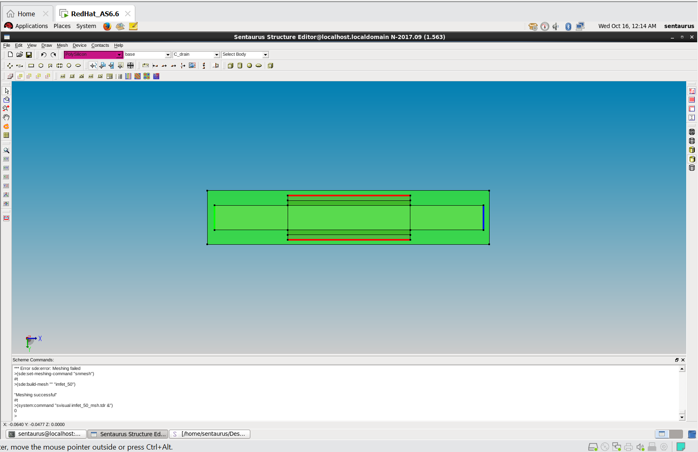
IMPLEMENTATION OF IMFET:

Slide 12
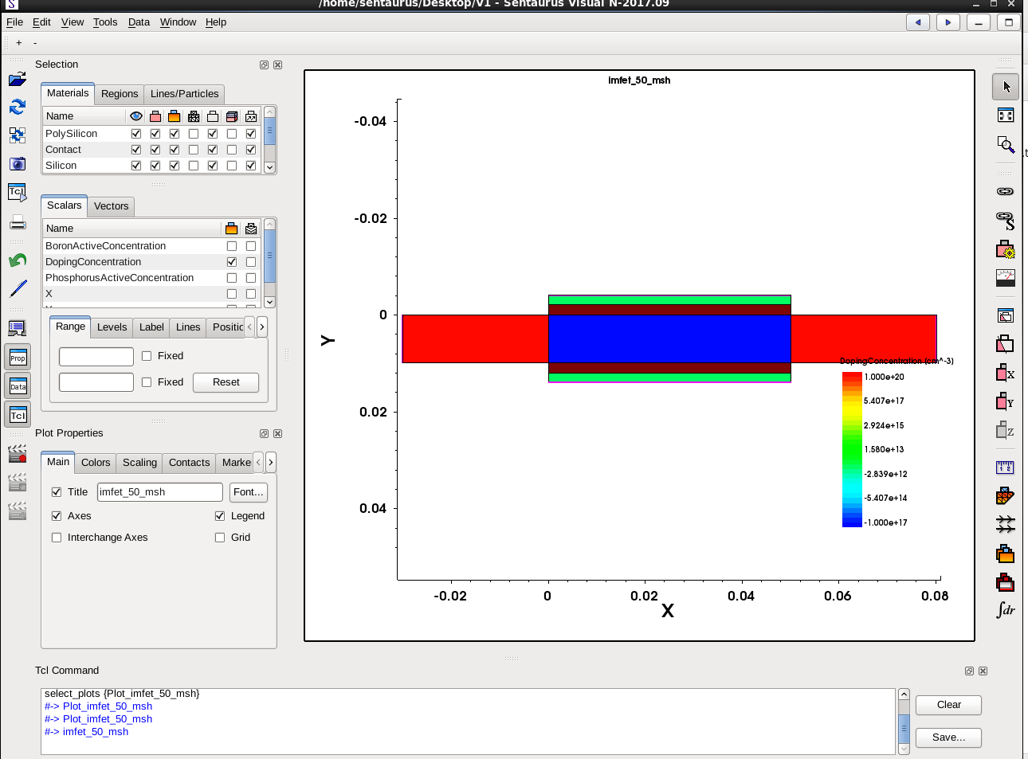
OUTPUT:

Slide 13
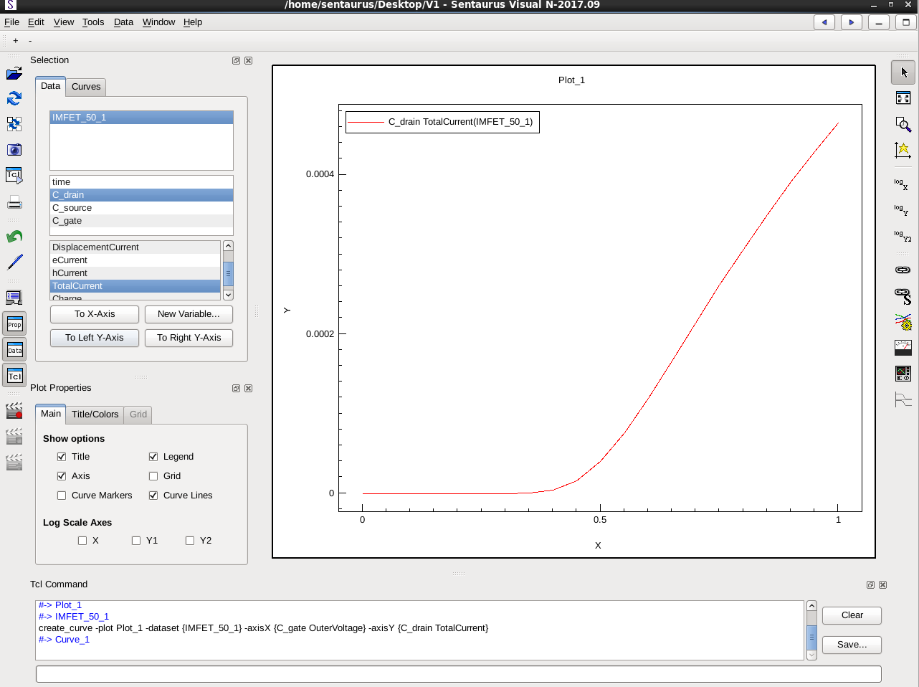
PLOT:

Slide 14
Challenges & Future Work
Challenges :
Short-Channel Effects: As FETs get smaller, the control of the gate over the channel (where current flows) becomes weaker, which again leads to poor performance and higher power consumption.
Heat and Reliability: Smaller devices generate more heat, which affects reliability and lifespan.
Future Work :
Advanced Measurement Techniques: As the devices shrinks in size the general methods may not be precise enough to work with so we will need new techniques to measure its properties accordingly.
Reliability Testing: As we already talked since the size shrinks testing reliability under various conditions like heat,voltage,temperature becomes more crucial, more advanced techniques like Self-Heating Effect Testing will be introduced to make sure that nano scaled FETs are strong.

Slide 15
Conclusion:
Simulation Overview: This tells about the structure of the nanoscale transistor with different regions like silicon, polysilicon, and contacts. The color-coded doping concentrations indicate that the source, drain, and channel regions are clearly defined, which is necessary for the transistor to work.
Output Characteristics: It shows how the drain current (output) increases as we apply more voltage to the gate (input).
Some advanced effects that happen when transistors get very small (like short-channel and quantum effects) need further study to improve accuracy.

Slide 16
REFERENCES:
. Chitrakant Sahu, Jawar Singh. "Device and circuit performance analysis of double gate junctionless transistors at Lg = 18 nm." The Journal of Engineering, 2014, Vol. 2014, Iss. 3, pp. 105–110. DOI: 10.1049/joe.2013.0269
. Kim, K. W., Tian, H., & Littlejohn, M. A. (1991). "Analysis of delta-doped and uniformly doped AlGaAs/GaAs HEMT's by ensemble Monte Carlo simulations," IEEE Transactions on Electron Devices, 38(8), 1731-1741
. H. Horie et al., 1991,C.-W. Lee et al., 2009&R. Rios et al., 2011 0018-9383 © 2019 IEEE
. J. Franco et al., "Superior NBTI Reliability of SiGe Channel pMOSFETs," Proc. IEDM, 2011
T. Grasser et al., "Recent Advances in Understanding the Bias Temperature Instability," Proc. IEEE IEDM, 2010
. Rodríguez-Ruiz, G. A., Gutiérrez-D, E. A., Sarmiento-Reyes, L. A., Stanojevic, Z., Kosina, H., Guarin, F. J., & García-R, P. J. (2015). Thermo-Magnetic Effects in Nano-Scaled MOSFET: An Experimental, Modeling, and Simulation Approach. IEEE Journal of the Electron Devices Society, 3(2), 78-84. DOI: 10.1109/JEDS.2015.2390629.

Slide 17
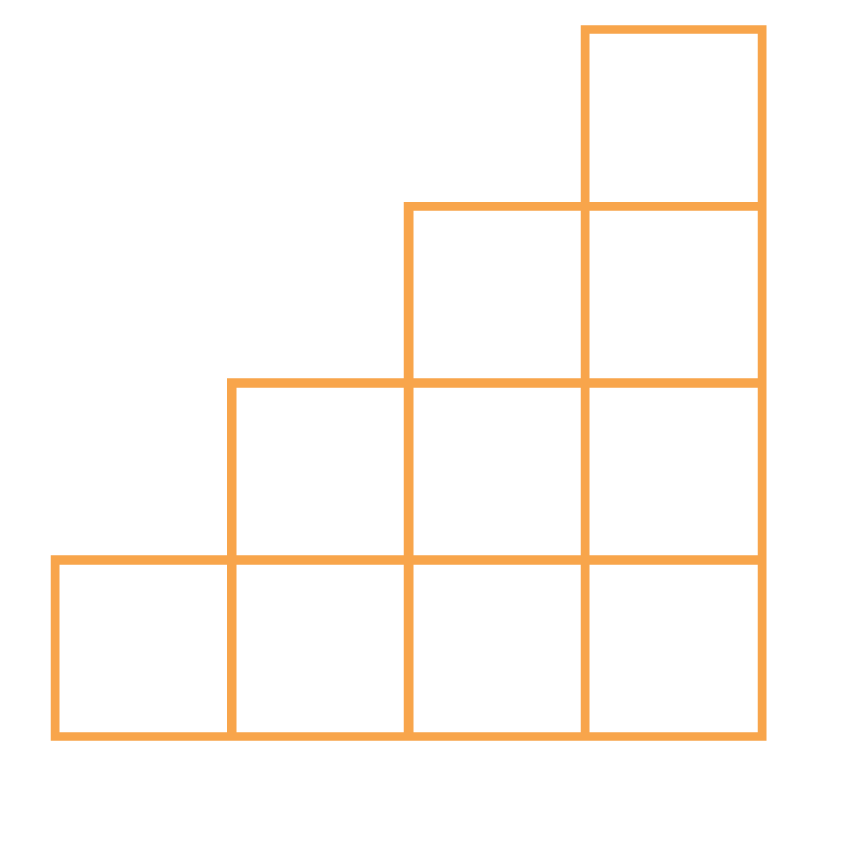
THANK YOU

